Slide 1

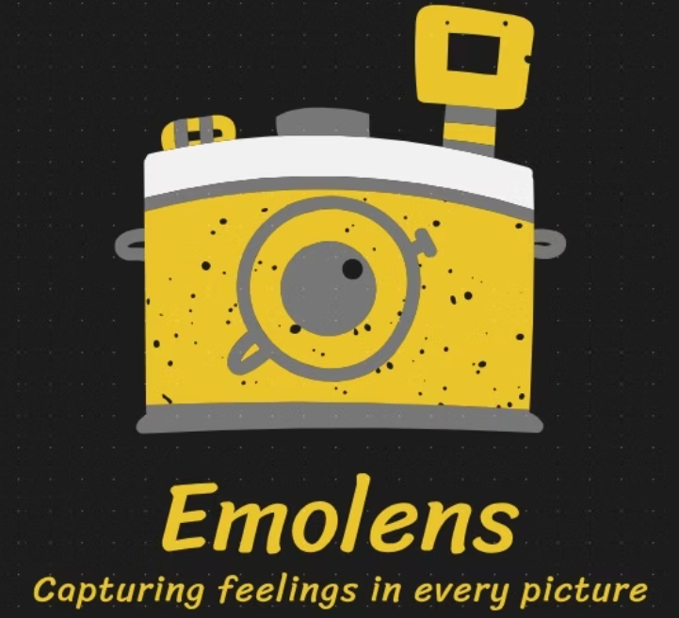
EMOLENS
(Human Sentimental Analysis Through Image Recognition)
Group Members
RIYA SINGHAL, MOHD AMAN, SUJAL SINGH
Under Supervison of
Internal: DR. AMAR SARASWAT, External: DR. AMAR SARASWAT School of Engineering and Technology

Slide 2
What does Emolens do?
Discover EmoLens, an innovative mini project blending advanced AI and machine learning to decode human emotions. Through state-of-the-art image recognition, EmoLens identifies nuanced emotional expressions in real time, promising to transform interactions across diverse fields from healthcare to customer service.
OVERVIEW OF TOPIC :-
•It is an innovative idea that harnesses the power of image recognition technology to analyze human emotions.
•The project aims to develop a system capable of detecting human emotions from images.
•To accurately classify emotions such as happiness, sadness.
•The process involves image acquisition, preprocessing, feature extraction, and emotion classification

Slide 3
Objectives
Identify and classify human emotions from facial expressions in images.
Continuously refine the algorithms to improve the accuracy of emotion detection.
Enable long-term monitoring of emotional trends to provide deeper insights and patterns over time.
Utilizing Convolutional Neural Networks (CNNs) to automatically extract and identify relevant features from images
Evaluate system accuracy and response time for visual inputs.

Slide 4

Methodology
Problem Definition: Define the problem statement and objectives of the project.
Dataset Collection: Gather a diverse and high-quality dataset of images representing various emotions.
Data Preprocessing: Preprocess the images to enhance quality and consistency.
Model Selection and Training: Choose an appropriate deep learning model for extracting and classification off emotions.
Testing and Validation: Conduct extensive real-world testing to validate the system's performance, get feedback from user

Slide 5
Problem Statement
Accuracy in Emotion Detection- Variability in human expressions ex happy face can be subtle smile or laughing
Datasets- A machine learning model required a large datasets of facial expressions fort accurate classifications.
Real-Time Processing-In many applications, emotions must be detected instantly to be useful
Scalability and Deployment- A trained model works fine or local machine but fails to integrate on web or mobile app
Data Annotation and Quality

Slide 6
Challenges limitations and solutions
Problem
Why it happens?
Solutions
Lack of labeled data
Limited datasets available
Use data augmentation & collect more data
Overfitting
Model memorizes data instead of learning patterns
Add dropout & regularization
Slow training
CNNs require high computation power
Use pre-trained models
Fails in real-time
Lighting, head movement affect results
Use OpenCV for real-time tracking
Difficult to deploy
Model too large for mobile use
Convert to TensorFlow
Privacy issues
Ethical concerns over facial tracking
Follow privacy policies & get user consent

Slide 7
Real time applications of Emolens
Healthcare
Social Media
•Patients often hide emotions; real-time analysis helps in early diagnosis. Monitoring patients emotional states for timely interventions. Example: A healthcare chatbot can analyze patient expressions during video calls and recommend mental health support.
Automatically tagging images with emotional labels. Users often experience negative emotions while browsing (e.g., stress, sadness). Emotion-based content curation can improve user experience and promote mental well-being
Gaming industry
Marketing
Changing game difficulty based on players reactions
Understanding consumer sentiments to improve strategies. Picture reviews will help to give accurate ratings
Education
Assessing teaching effectiveness through student reactions

Slide 8

Expected Outcomes
Improved Human-Computer Interaction
The model will successfully classify human emotions as Happy or Sad based on facial expressions
Mental Health Monitoring
Long-Term Emotional Trends
Informed Decision-Making
The model can be adapted to detect more emotions (e.g., Angry, Surprised) in future.

Slide 9
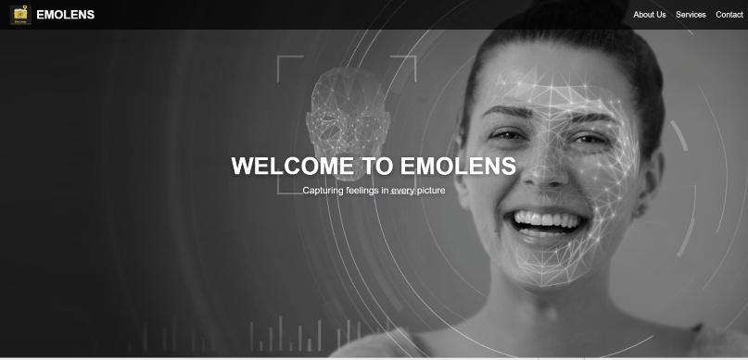
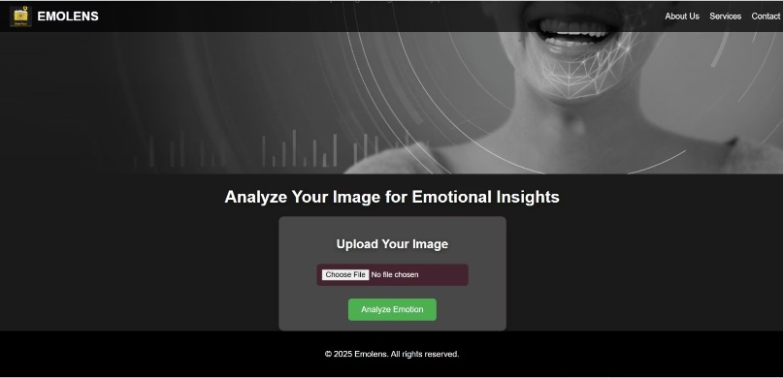
Front end and Interface
Welcome Home Page for Emolens
upload image from local drive to analyse the emotions
created using html,css,js,react

Slide 10
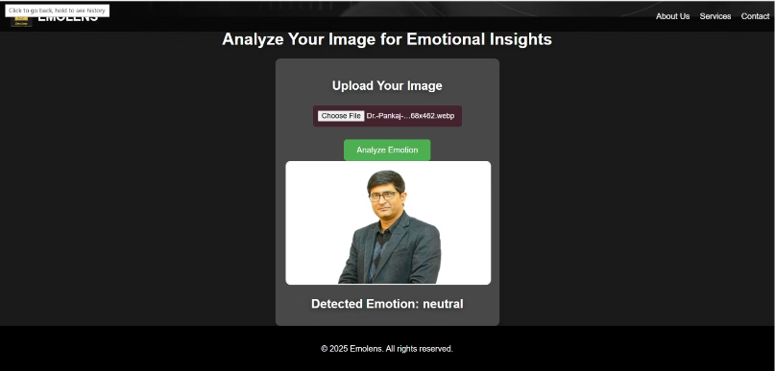
Real time Output for Emolens
ex-here is a photo of Dean Sir SOET KRMU. Firstly we upload the photo from local drive and then the Emolens analyse the image and gives output. Here the output given is Neutral

Slide 11
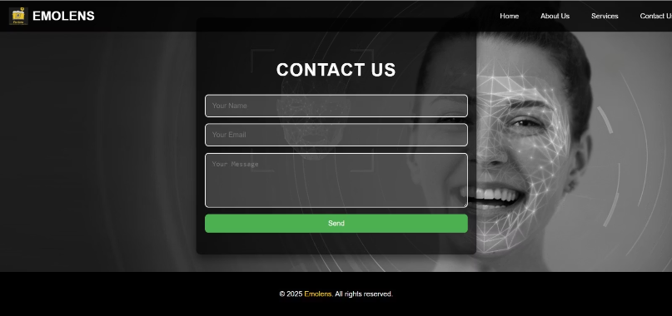
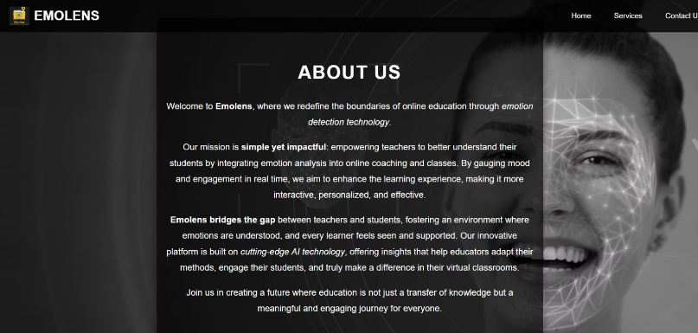
Web Pages
Contact us web page
About us web page

Slide 12
The Problem: Current Challenges in Emotion Recognition Technology
Accuracy Limitations
Data Bias
Real-Time Responsiveness
Many existing systems struggle to accurately detect subtle or mixed emotions in varied lighting and angles.
Emotion datasets often lack diversity, impacting model performance across different demographics.
Processing delays hinder practical applications like live interaction or adaptive systems.
Privacy issues
Slow training
Not everyone agrees to share its image
CNNs require high computation power

Slide 13
Project Overview: How EmoLens Works
Image Capture
Emotion Detection
Output & Feedback
EmoLens utilizes devices’ cameras for live image acquisition of facial expressions and gestures.
Deep learning models analyze landmarks and pixel patterns to classify emotions like joy, sadness, anger, and surprise.
Real-time visual feedback presents recognized emotions, facilitating responsive user experiences.

Slide 14
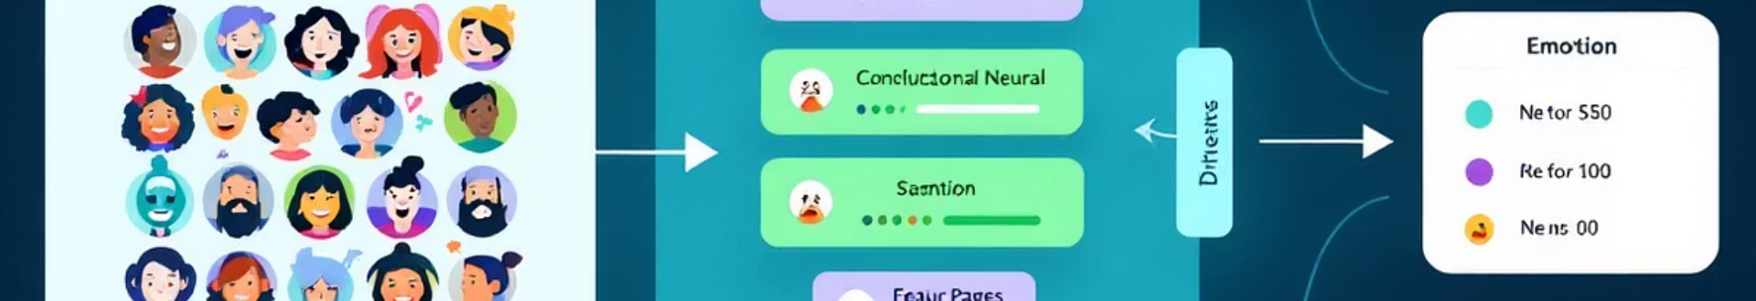
Technical Architecture: Machine Learning Models & Image Processing Pipeline
Preprocessing
Convolutional Neural Networks
Face detection and normalization to standardize input images for consistency.
Powerful CNN models extract facial features and learn complex expression patterns.
Classification Layer
Post-processing
Multi-class classifiers assign emotions based on extracted features with probabilistic outputs.
Confidence scoring and smoothing to enhance prediction stability over successive frames.

Slide 15
Dataset Selection and Preparation for Emotion Recognition
Dataset Choice
Data Augmentation
EmoLens trains using established emotion datasets like FER-2013 and CK+, capturing broad emotional ranges.
Applied rotations, scaling, and lighting adjustments to improve model robustness against real-world conditions.

Slide 16





Implementation Challenges and Solutions
Challenge: Lighting Variations
Models struggled under inconsistent lighting conditions which distorted facial features.
Solution: Enhanced Preprocessing
Implemented histogram equalization and adaptive filtering to normalize image brightness and contrast.
Challenge: Overfitting
Early models fit too closely to training data, limiting generalization.
Solution: Regularization Techniques
Used dropout layers and cross-validation during training, improving model adaptability.

Slide 17

Live Demonstration: EmoLens in Action
Step 1: Capture
User records or streams a facial video or image.
Step 2: Model Processing
EmoLens analyzes the input using the trained machine learning pipeline.
Step 3: Display
Detected emotions are visually presented, with confidence levels shown.

Slide 18
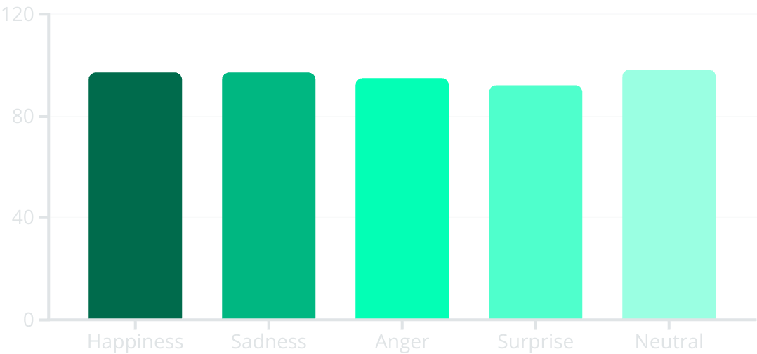
Performance Metrics and Accuracy Analysis
Our model achieves high accuracy, especially detecting happiness and neutral expressions, reflecting solid generalizability. Some emotions like surprise pose more challenge due to overlapping facial cues.

Slide 19

Future Enhancements and Conclusion
1
Expand Dataset Diversity
Incorporate wider demographic data for inclusivity and fairness.
2
Multimodal Emotion Detection
Combine voice and gesture analysis with facial recognition for richer insights.
3
Edge Computing Integration
Deploy EmoLens on mobile and IoT devices for offline, real-time use.
4
Conclusion
EmoLens showcases promising advances in human emotion AI, poised to impact various industries by enhancing understanding and interaction capabilities.

Slide 20

THANK YOU

